Slide 1
Reliable Multicast For RTM

Slide 2
Outline
New Transport Protocol for RTM
Motivation and Design goals
Multicast Performance
One-to-one connection Case
Fan-out model Case
Fan-in model Case
Reliable UDP Multicast (RM-UDP) Solution
Current NSQ Design
Design Assumptions and Considerations
Design of RM-UDP
NSQd address management and lookup
NSQd and Consumer communication

Slide 3
New Transport Protocol for RTM
Motivation
Large number of concurrent connections between NSQ Daemon and Subscribers causes CPU contention and then leads to high latency for message delivery.
Need a new transport protocol for connections between NSQ Daemon and Subscribers to alleviate CPU contention.
Design Goals
Low Latency: achieve low latency for message delivery
Scalability: allow RTM to scale to large number of subscribers
Reliability: guarantee reliable message delivery
Previous investigation: UDP and TCP
UDP has slightly lower latency and lower CPU utilization than TCP
However, for both protocols, CPU utilization and latency dramatically increase as the number of subscribers increases.
Another direction to explore
Multicast, as it leverages the network for one-to-many message delivery
What’s the performance of multicast?

Slide 4
Outline
New Transport Protocol for RTM
Motivation and Design goals
Multicast Performance
One-to-one connection Case
Fan-out model Case
Fan-in model Case
Reliable UDP Multicast (RM-UDP) Solution
Current NSQ design
Design Assumptions and Considerations
Design of RM-UDP
NSQd address management and lookup
NSQd and Consumer communication

Slide 5
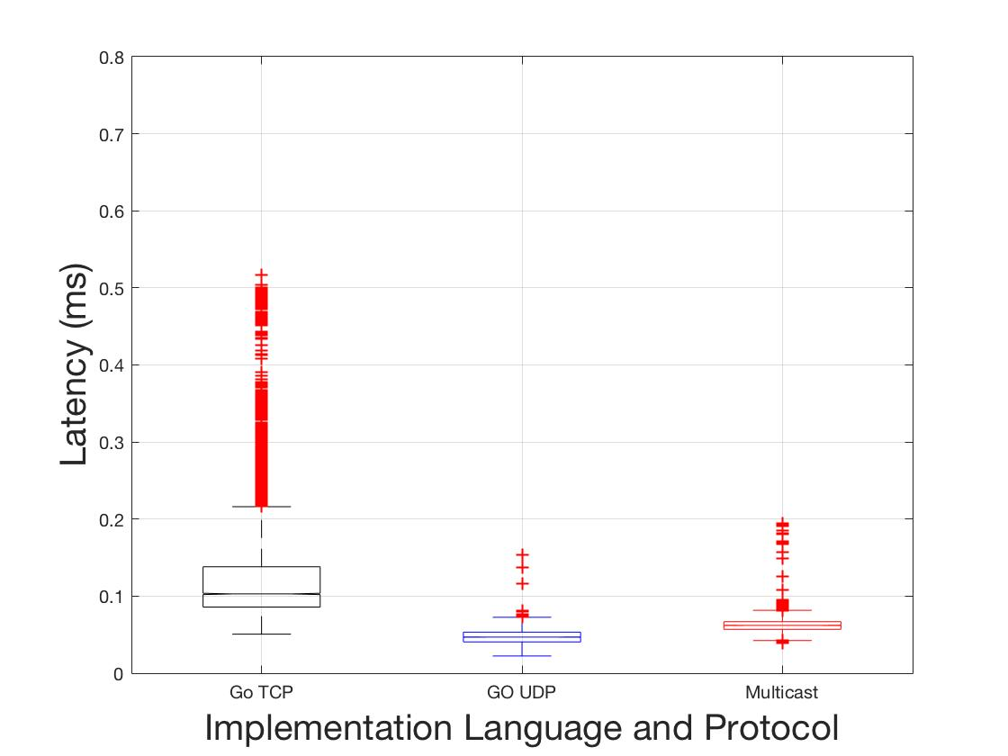
Multicast Performance
Multicast Performance Test Environment
Programs written in golang (as NSQ) using x/net/ipv4 package for multicast socket
Tested on Two Huawei machines connected through a switch.
One-to-one connection Case Setup
On one server, a simple sender keeps sending packets to a multicast address
On the other server, a receiver program receives packets from the address
One-to-one connection Case Results
Throughput of multicast is worse than that of TCP or UDP
TCP is max at 7.4 Gbps
UDP is around 2.7 Gbps
Multicast is 1.2 Gbps
Latency of multicast falls between TCP and UDP
TCP is around 0.1 ms
UDP is around 0.05 ms
Multicast is around 0.07 ms

Slide 6
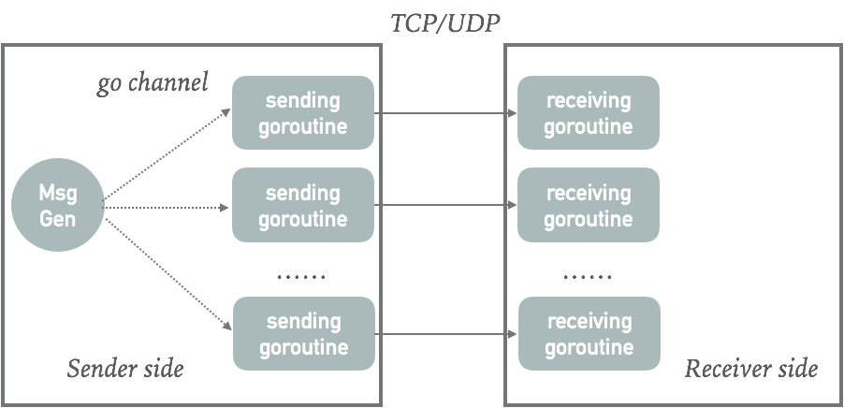
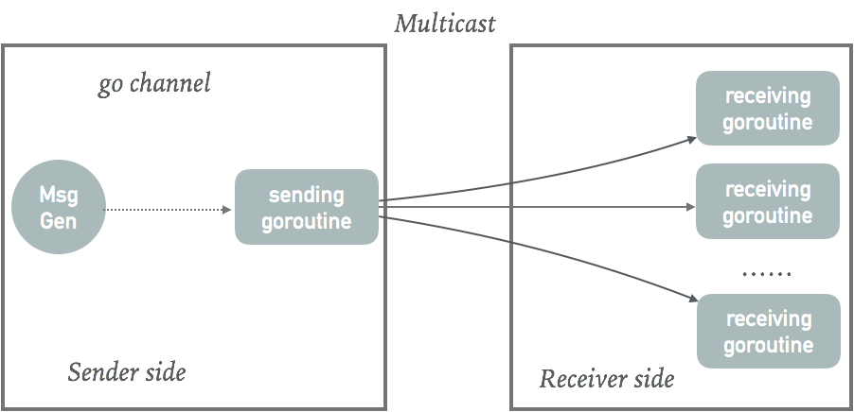
Multicast Performance
Fan-out Model Case Setup (one-to-many)
Sender and receiver run on two different machines (Huawei S1 and S2).
One message generation goroutine at sender side, multiple receive goroutines at receiver side
Message generation goroutine generates signal sending to sending goroutine(s) every 5ms which triggers the sending goroutine sending a 1000bytes message.
For TCP/UDP: one sending goroutine at sender side corresponds to each receiving goroutine at receiver side with TCP/UDP connection
For Multicast: only one sending goroutine at sender side, it sends to message through multicast socket, each receiving goroutine reads from same multicast address.

Slide 7
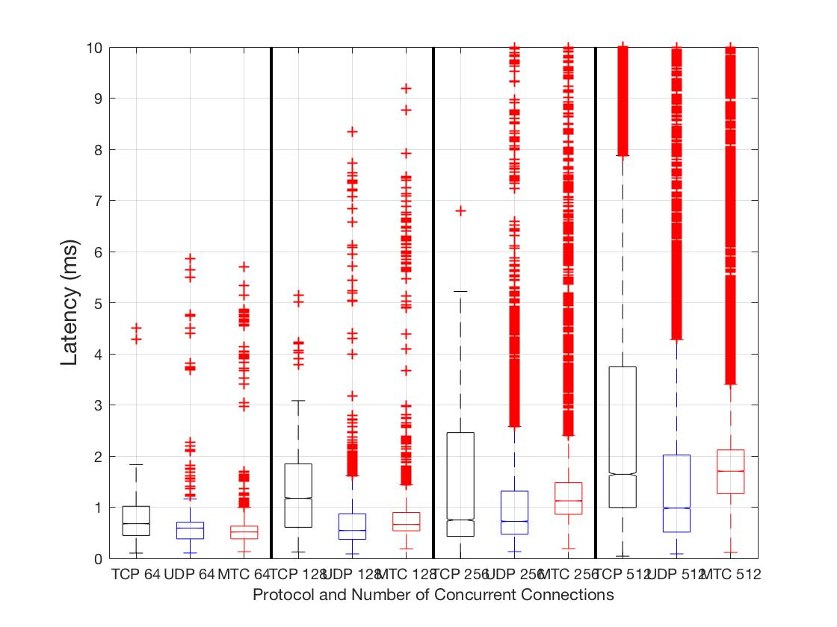
Multicast Performance
Fan-out Model Case Results
Latency: for different level of concurrency (in terms of number of receiving goroutines), multicast has lower latency than TCP and slightly higher latency than UDP. There’s no significant latency benefit of multicast for fan-out. This is likely because the receiver side is a bottleneck limiting multicast performance.
CPU utilization: on the sender side, multicast has much lower CPU utilization than TCP and UDP, since multicast messages are sent through only one socket.

Slide 8
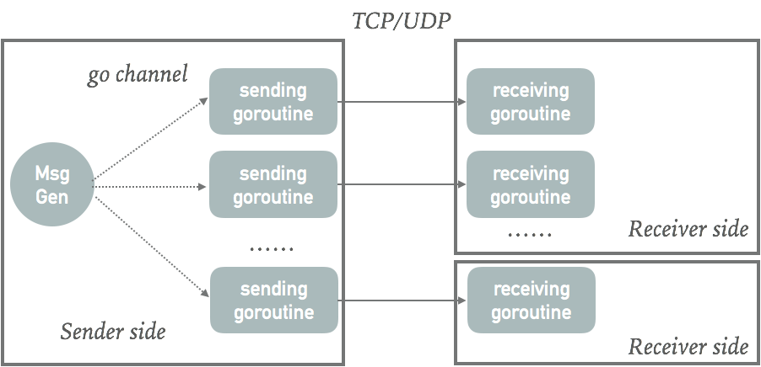
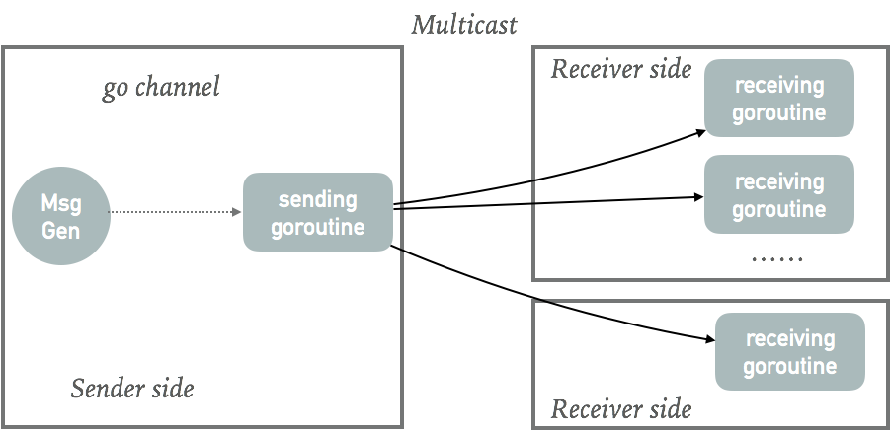
Multicast Performance
Revised Fan-out Model Case Setup
Remove receiver side bottleneck
Use three machines instead of two
One server (huawei1) as sender, and two other machines as receivers
One receiver (on huawei2) runs multiple receiver goroutines whereas the other receiver (on huawei3) runs only one goroutine.
Measure only the latency of a single goroutine (on huawei3), whereas in previous model, we sampled latency from all goroutines and averaged them.
For TCP/UDP, sending goroutines send out message in an order, the order also affects the latency for each connection.

Slide 9
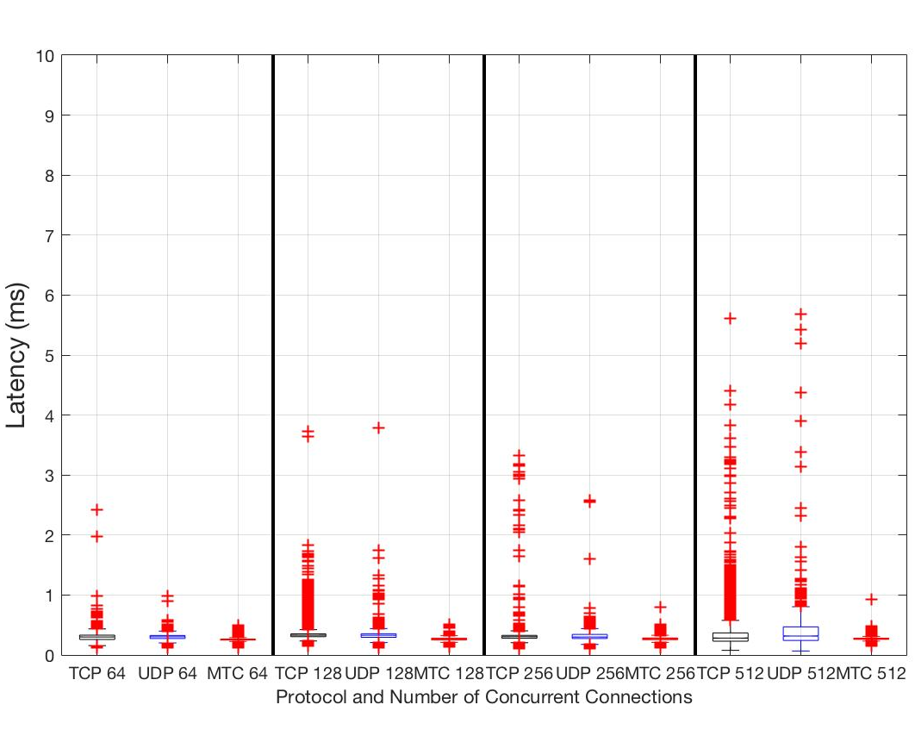
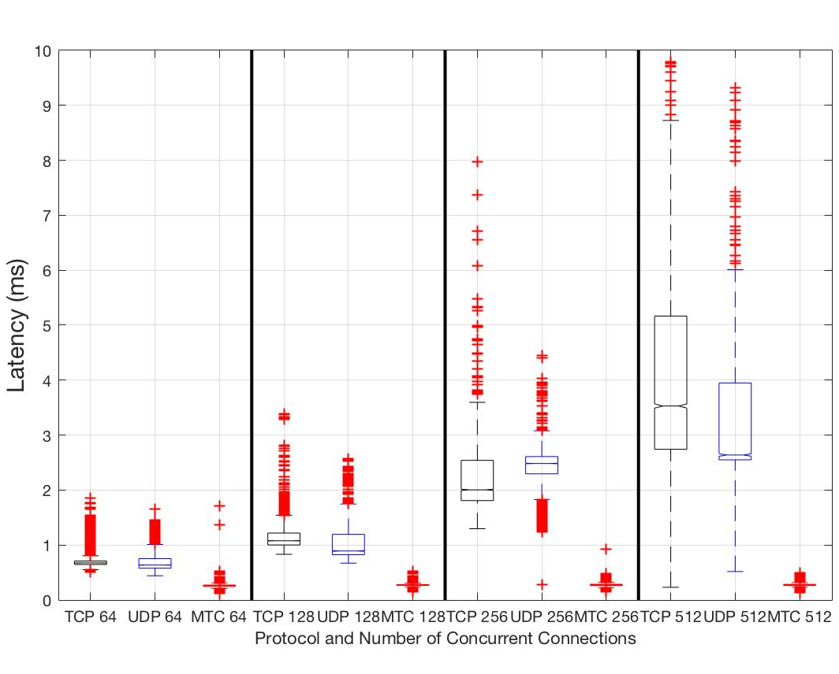
Multicast Performance
Revised Fan-out Model Case Results
Two comparisons: the unicast connection to the goroutine receiver is 1) the first one to send message, 2) the last one to send message.
Latency: For both cases, the latency of multicast is smaller than TCP and UDP. For the first case, the latency of TCP and UDP remain at the same level as we increase concurrency. However, for the second case, they increase dramatically as concurrency increases. Multicast reduces the latency by removing message copy and sending in sender.
First one to send message
Last one to send message

Slide 10
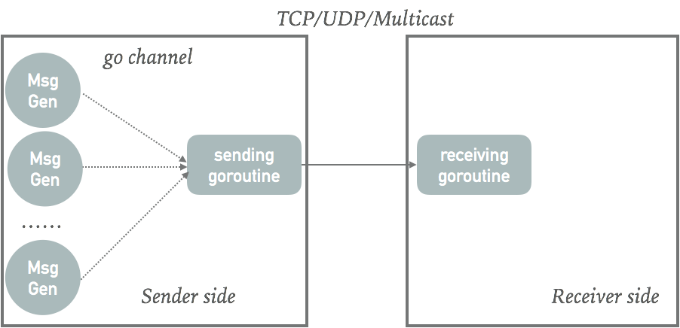
Multicast Performance
Fan-in Model Case Setup (many-to-one)
Sender and receiver run on two different machines (Huawei S1 and S2).
Multiple message generation goroutines and one sending goroutine on sender side, and one receiving goroutine on receiver side.
Each message generation goroutine generates signal to sending goroutine every 5ms which triggers the sending goroutine sending a 1000bytes message.
Only one socket connection between sender and receiver, which is handled by the sending goroutine at the sender side and receiving goroutine at the receiver side.

Slide 11
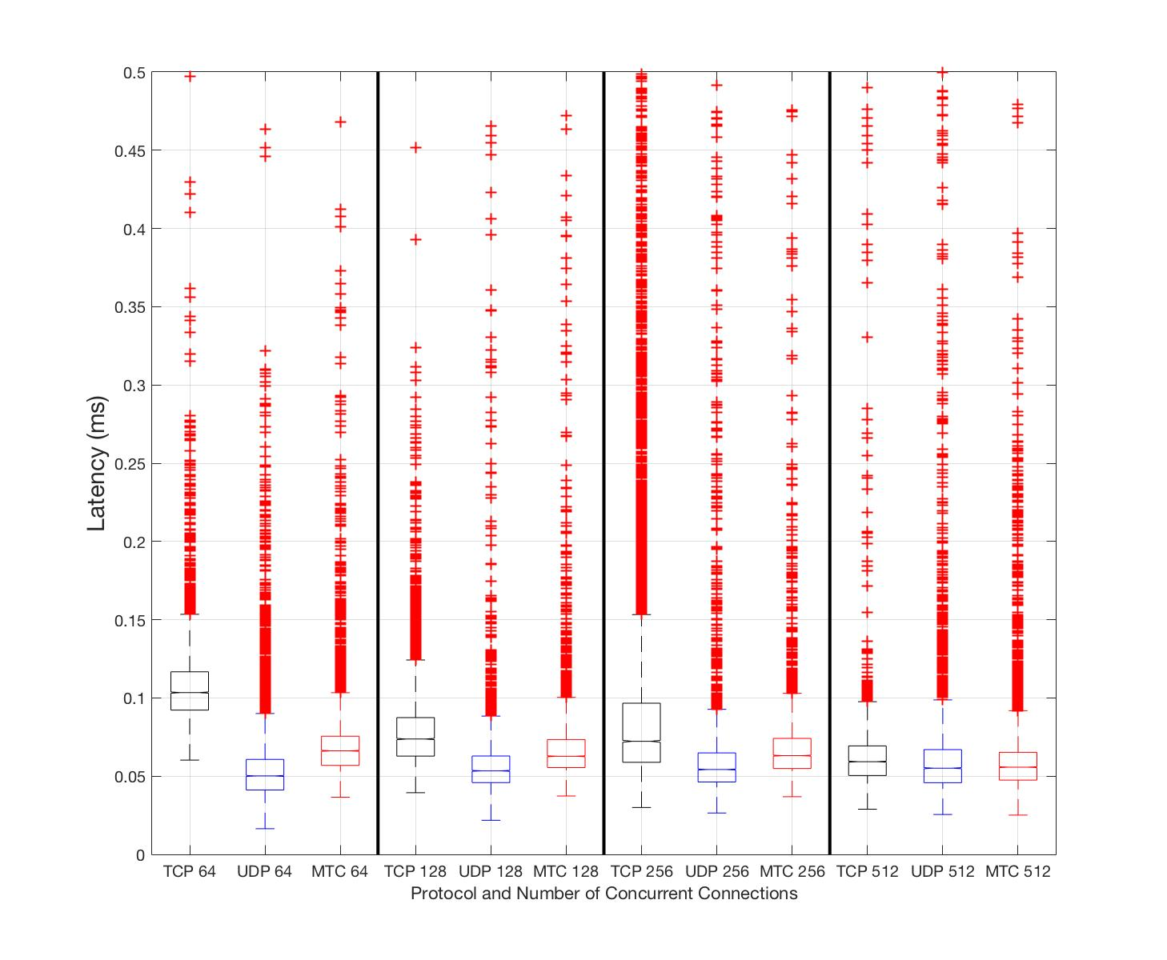
Multicast Performance
Fan-in Model Case Results
Latency: for different level of concurrency (in terms of number of message generation goroutines), multicast has slightly higher latency than UDP, and lower latency than TCP.
CPU utilization: for all cases, CPU utilization of multicast is higher than TCP, for most cases (except for 512), multicast has higher CPU utilization than UDP, though not by a lot.

Slide 12
Multicast Performance
Conclusion About Multicast Performance
For fan-in model (i.e., many-to-one or one-to-one), UDP multicast has slightly higher latency than UDP but lower latency than TCP. Multicast has typically slightly higher CPU utilization than TCP and UDP.
This is not a primary candidate for multicast, i.e., only one connection, but even in that scenario multicast does not do much worse, latency-wise, than unicast
For fan-out model (i.e., one-to-many which is common in pub-sub system), the overall CPU utilization for multicast is dramatically lower, since it only needs to send each message once. The latency of multicast is lower than TCP and UDP.
This is the primary scenario where multicast is beneficial
Multicast offloads copy and sending to multiple destinations from sender to network.
Drawbacks of Multicast
It requires network support of multicast. Need to have control over that network capability to ensure support for RTM multicast solution
The transmission (network) paths of multicast packets can be different from unicast. That means different propagation delay and forwarding delays (this is not present in our experiments, since sender and receiver are only one-hop away from each other).

Slide 13
Outline
New Transport Protocol for RTM
Motivation and Design goals
Multicast Performance
One-to-one connection Case
Fan-out model Case
Fan-in model Case
Reliable UDP Multicast (RM-UDP) Solution
Current NSQ Design
Design Assumptions and Considerations
Design of RM-UDP
NSQd address management and lookup
NSQd and Consumer communication

Slide 14
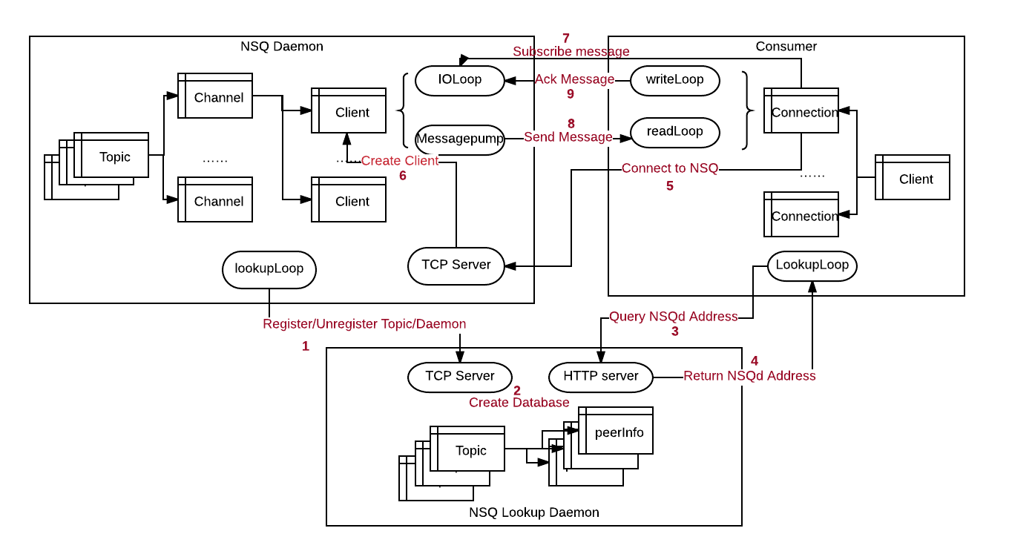
Current NSQ Design
NSQd Address Management and Lookup
1. NSQd connects to NDQLookupd and register/unregister topic/channel
2. NSQLookupd creates databases to store daemon, topic, and channel info
3. Consumer queries NSQd information for certain topic
4. NSQLookupd returns the information of NSQds registered for the topic

Slide 15
Current NSQ Design
Consumer and NSQd Communication
5. Consumer connects to each NSQd returned from NSQLookupd
6. NSQd generates client and IOLoop, Messagepump goroutines for each connection
7. Consumer sends SUB message to subscribe topic and channel.
8, 9. NSQd sends published messages to each consumer, consumer acknowledges each message with FIN message. RDY message for sending rate control between daemon and consumer, and HEARTBEAT message for liveness check.

Slide 16
Reliable UDP Multicast – Design Assumptions
Assumption 1: in-order delivery for the network in most cases
Most network devices deliver packets of a given flow in order. We, therefore, assume that end-to-end in-order delivery is the norm, and violated only in rare cases, like path changes.
This assumption helps simplify packet processing and reduce the time for detecting message loss, i.e., receipt of an out-of-order message means a packet loss.
Violation of this assumption only leads to redundant messages (false positive detection of message loss), and does not affect operational correctness.
Assumption 2: message loss is relatively rare.
The system is deployed in a well provisioned network, where message losses are be relatively rare, i.e., congestion is not common
Under this assumption, a linear list offers a simple yet efficient way to store message loss information.
Violation of this assumption leads to (linear) increase in search time for lost packets, but does not affect correctness.

Slide 17
Reliable UDP Multicast – Design Assumptions
Assumption 3: messages are independent of each other and timeliness of delivery is important, i.e., stale messages are not useful
A message is no longer wanted if it is not received after a certain time (consistent with our goal of low latency). Messages are atomic, i.e., a message content does not depend on other messages.
This enables a simple and scalable reliability mechanism that delivers messages in the order in which they are actually received. (An in-order delivery can be enforced with reordering in application level)
A consequence of this assumption is that some list messages may never be recovered (once a certain retransmission time period is exceeded). Consumers that require 100% reliability should use unicast instead of multicast.

Slide 18
Reliable UDP Multicast Solution
Design Considerations For Multicast
Multicast address management
One multicast address per topic
For a given topic, the same multicast address is used across all daemons with producers publishing to the topic.
This reduces the number of connections on the consumer side, and the number of multicast addresses used.
A mechanism is needed to manage assignment of multicast addresses to topics. The NSQlookup daemon is a natural candidate for performing such function.
The NSQlookup daemon will return the multicast address assigned to a topic, when an NSQd registers for the topic.
Reliable Transmission
Acknowledgement of each message for reliability requires tracking the ACK state of individual consumers which is not scalable when the number of consumers is large (ACK volume can overwhelm NSQd).
Therefore, NACK is used instead, a NACK indicate message loss detected.
NSQd only reacts to NACKs without tracking the state of individual consumers.
A message must remain in NSQd in-flight queue until all consumers can be assumed to have received it (no NACK for the message received after certain time)

Slide 19
Reliable UDP Multicast Solution
Additional Considerations
Tracking consumer info
Tracking consumer info would require separate exchanges (when joining and leaving). This could be expensive when the number of consumers is large, but is a one time operation.
Because joining a multicast group does not require interacting with NSQd, we lose the ability to track which customers subscribe to a given topic
This capability can be added back through an out-of-band hand-shake
Congestion control between NSQd and consumer
RTM already includes topic-level rate control between producers and NSQd
Additional rate control may possibly be realized by adjusting in-flight queue based on NACK information (more NACK means congestion at least for some consumers), but using that information can be problematic (how to set “correct” transmission rate across heterogeneous receivers?)
Tradeoff between Reliability, Latency, and Resources
Greater reliability can be realized by increasing the safe-time (the time a message stays in in-flight queue). This will, however, require a larger in-flight queue size or result in longer latency due to blocking of message transmissions because of full in-flight queue.
Faster retransmissions in cases of multiple losses call for more aggressive reporting of lost messages by consumers. This would likely result in more retransmissions and consequently message duplication and greater resources consumption.
Heterogeneous consumers
Individual consumers may require stronger reliability than multicast can offer
Such consumers may be allowed to use TCP unicast instead, if there are few of them

Slide 20
Outline
New Transport Protocol for RTM
Motivation and Design goals
Multicast Performance
One-to-one connection Case
Fan-out model Case
Fan-in model Case
Reliable UDP Multicast (RM-UDP) Solution
Current NSQ Design
Design Assumptions and Considerations
Design of RM-UDP
NSQd address management and lookup
NSQd and Consumer communication

Slide 21
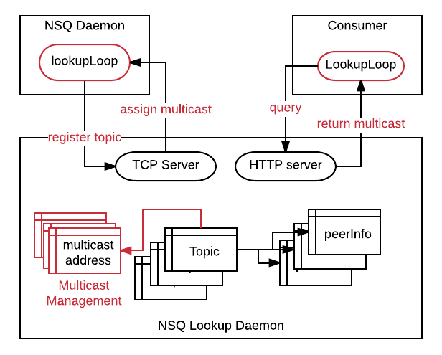
Design of RM-UDP
NSQLookupd address management
When multicast is enabled in NSQLookupd (with multicast_flag), it reserves some multicast addresses in the network and UDP ports on each server. It also maintains available multicast addresses and ports and used ones.
When NSQd registers itself to a topic, NSQLookupd returns the multicast address and port corresponding for the topic. If the topic is new, then NSQLookupd assigns a new multicast address and port to the topic, and returns the assigned address and port.
NSQd lookup in Consumer
Consumer queries NSQLookupd for NSQd info on a given topic
It returns NSQd information related to that topic.
NSQLookupd returns the information (unicast address) of NSQds that publish the topic and the multicast address/port for the topic.
Consumer can uses multicast address if it wants to subscribe to multicast channel of the topic. Otherwise, it connects to all NSQds using unicast address for other channels.

Slide 22
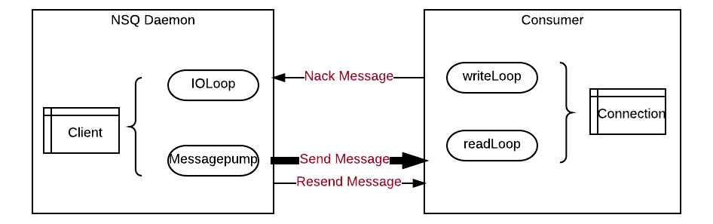
Design of RM-UDP
Consumer and NSQd Communication
Connection Setup
After NSQd registers a topic and receives the multicast address for the topic, it creates a client and a channel specific for multicast (named “multicast”) using the assigned multicast address (see slide 14 for the detailed structure of a client and channel)
Consumer who subscribes to multicast channel of topic simply joins (local multicast functionality) and listening to the multicast address of the topic (no explicit sending of SUB message)
HEARTBEAT messages are sent every heartbeat interval.
RDY messages and FIN messages sent from consumers are disabled.
Connection Cleanup
When NSQd wants to close multicast connection, it can either actively sends a CLOSE message to multicast connection before it closes the connection, or it simply closes the connection.
Consumer closes multicast connection when it receives a CLOSE message or no message (including HEARTBEAT message) are received for several heartbeat intervals.

Slide 23
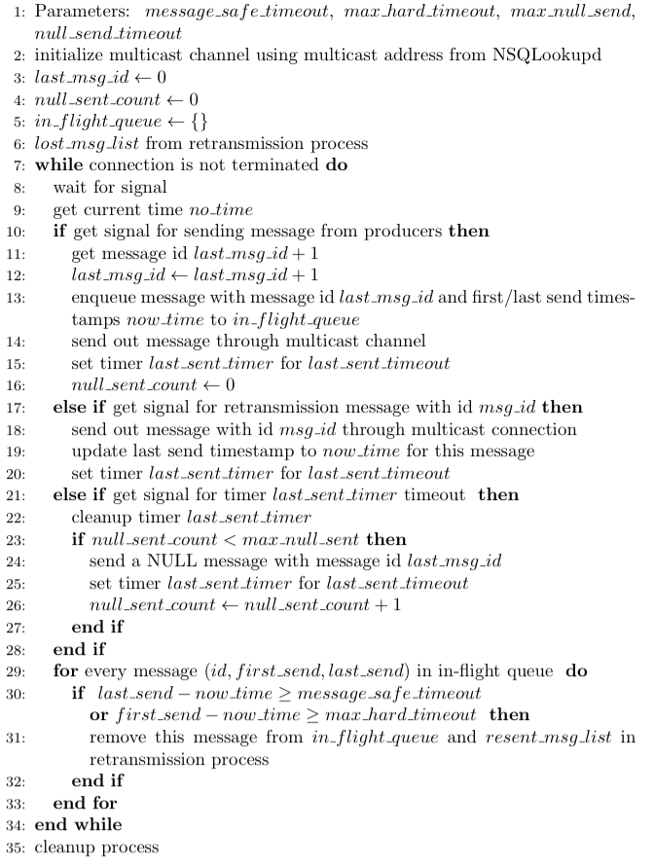
Design of RM-UDP
Consumer and NSQd Communication
Message Sending (Daemon)
NSQd sends/resends message to the multicast address when signaled to, it also maintains each message along with its message id, first send timestamp and last send timestamp using in-flight queue.
If no message sent out for last-send-timeout, NSQd sends up to max-null-send NULL messages to ensure the receiver can detect message loss for last sent message in a timely fashion. (see slide 28 for more details about NULL message)
A message in in-flight queue times out if
more than max_hard_timeout has elapsed since it was first sent,
or more than message_safe_timeout has elapsed since it was last sent.
Timed-out message is removed from in-flight queue. (see slide 29 for details about checking message timeout)

Slide 24
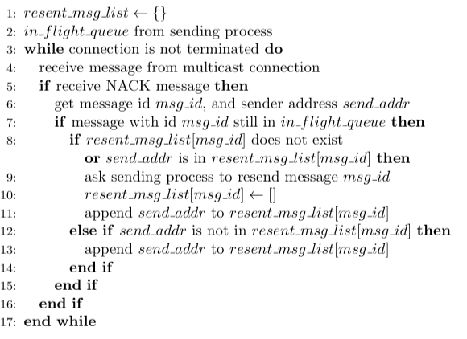
Design of RM-UDP
Consumer and NSQd Communication
Lost Message Retransmission (Daemon)
When NSQd receives a NACK for a message, it first checks if the message is still in in-flight_queue. If it’s, do following.
If previous NACK (for the same message id) does not exist, resend the message (through multicast), add the sender (of the NACK) to resend_msg_list.
If previous NACK exists
and is sent from the same sender, resend the message (through multicast), empty resend_msg_list for the message, add only the sender.
and is not sent from the sender, append the sender to resend_msg_list for the message.
The message sending process will remove a message from resend_msg_list when the message is removed from in_flight_queue.

Slide 25

Design of RM-UDP
Consumer and NSQd Communication
Message Loss Detection (Consumer)
When receiving a regular message from a daemon, we update the last_send_id for that daemon.
A message loss is detected when
Arrived message with message id larger than last_send_id +1
Arrived NULL message with larger message id than last_send_id
After a loss is detected, NACK message is sent to corresponding NSQd with message id of lost message(s), and related information (message id, timestamps of first NACK send time and last NACK send time) is stored in lost_msg_list.
A NACK will be only be resent when nack_resend_timeout has elapsed after NACK of the message was last sent, and retransmission has not been received
Message will be removed from lost_msg_list if the retransmission of message is received or max_hard_timeout has elapsed since the NACK of the message was first sent. (see slide 29 for detail about checking message timeout)

Slide 26
Design of RM-UDP
Consumer and NSQd Communication
Parameters
message_safe_timeout: represents the maximal period of time for daemon to be aware of message loss and resend a message.
should be set to slightly larger than max_rtt + max_null_send * last_send_timeout + 2n* nack_resend_timeout, to allow recovery of at least max_null_send consecutive lost messages and n NACK/message retransmission losses. n could be set to 1. (see slides 28 and 29 for details about the reasoning),
max_rtt: allowed maximal round trip time between NSQd and consumer for basic multicast reliability, any consumer with a larger RTT will have a lower level of reliability. A larger max_rtt means more tolerance for consumers with large RTT.
max_null_send: represents the maximum number of null messages to send after a regular message (see slides 28 for details about NULL message). Larger value means multicast can handle more complicated cases for message loss.
can be set to 2 or 3.
last_send_timeout: represents the interval to send a NULL message after a regular or NULL message (see slides 28 for details about NULL message). Smaller last_send_timeout means lower latency for detecting message loss, but also leads to more NULL messages.
can be set to larger than the average message interval.

Slide 27
Design of RM-UDP
Consumer and NSQd Communication
Parameters
nack_resend_timeout: represents the time for consumer to resent NACK if lost message has not been received by consumer.
can be set by each consumer to slightly larger than its RTT to daemon. If the RTT is not known, it can be set to slightly larger than max_rtt.
max_hard_timeout: represents the maximum period of time available for daemon/consumer to achieve message reliability.
If message loss has not been resolved after this period since message first sent, then daemon will stop resending the message, and remove it from in_flight_queue
If message loss has not been resolved after this period since message loss first detected, then consumer will stop resending NACK messages and remove it from loss_msg_list.
Tradeoff among those parameters
For better Latency for recovery from loss:
Smaller last_send_timeout, nack_resend_timeout
For better Reliability:
Larger max_rtt, larger max_null_send , larger max_hard_timeout, and larger n
For less Memory:
Smaller message_safe_timeout, and smaller max_hard_timeout
For less Traffic:
Larger last_send_timeout

Slide 28
Design of RM-UDP
Other Design Details
NULL message for timely message loss detection
It could be that a message is sent and for a long time no message is sent. Then it would be too late for the receiver to detect the loss of the last message.
We send NULL message containing the message id of last send message by the daemon if no message is sent for null_send_timeout. And we will send up to max_null_sent, in case NULL message is also lost.
So that receiver (consumer) will detect the loss within max_null_sent *null_send_timeout which allowing at most max_null_sent -1 NULL message losses.
Unlike heartbeat, NULL message will stop after continuously sending max_null_sent NULL messages to avoid unnecessary traffic.
Use timestamp instead of Timers for timeout
For message sending timeout and NACK message sending timeout, we use timestamps to track the sending/resending time of messages and check the timeout of message based on those timestamps, avoiding using individual timer which saves computing resources.
Also, priority queue is used, based on timeout of each message, finding timeout message(s) is quick.
The side effect of using timestamp is delaying the time for detecting timeout.

Slide 29
Design of RM-UDP
Other Design Details
Check timeout using timestamp
For message sending, timeout is checked whenever something message needs to be sent or resent. This delays message timeout for uncertain amount of time. However, this only delays the removal of message from in_flight_queue, does not affecting correctness. And message timeout will be checked after sending a message, therefore, it has nearly no effects on in-flight queue size.
For message loss detection, timeout is checked when we receive a message or there’s not checking for nack_resend_timeout. It delays message timeout for at most nack_resend_timeout. Therefore, at most 2* nack_resend_timeout is needed to resend a NACK.
Limiting size of in_flight_queue
When we have large message_safe_timeout and large max_hard_timeout, the size of in_flight_queue can be large when message rate is high.
A potential solution is limiting the size of in_flight_queue, when the size of in_flight_queue reaches the limit, after each message added, we remove the oldest message (even though it has not yet timed-out)
This weakens reliability when the message rate is high.

Slide 30
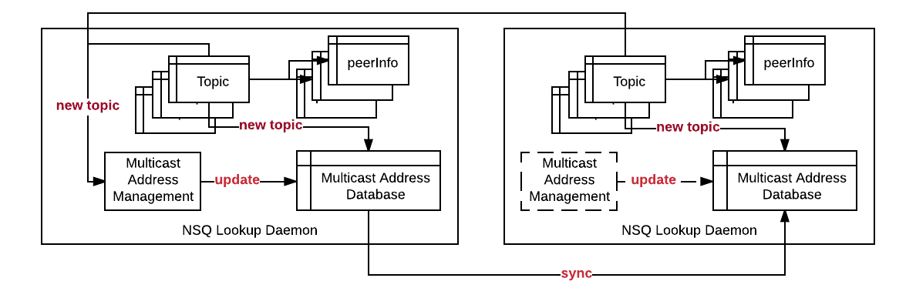
Distributed NSQLookupd
Multiple NSQLookupds
The multicast address of a topic should be global unique
NSQLookupds should return the same multicast address for a topic
Proposal: address management designated nsqlookupd
Elect one designated NSQlookupd for multicast address management, for other NSQlookupds, the management function is deactivated.
For a new topic, first check local database for multicast address, if not exist, get address from multicast address management in designated NSQlookupd.
The multicast address database (map of address and topic) are synchronized among NSQlookupds when it is changed in designated NSQlookupd.

